Slide 1
An Approach to Evaluate and Measure Quality among Multiple Alignments
By
Faisal Ahmed
Reg. No.: 2011331047
Supervisor:
Biswapriyo Chakrabarty
Lecturer,
Dept. of CSE, SUST
Co-Advisors:
Md. Ruhul Amin Shajib
Assistant Professor,
Dept. of CSE, SUST
Md. Eamin Rahman
Assistant Professor
Dept. of CSE, SUST

Slide 2
What is Sequence Alignment
Sequence alignment is a way of arranging the sequences of DNA or RNA to identify regions of similarity that may be a consequence of functional or evolutionary relationships between
the sequences.

Slide 3
Sequence Alignment
Global Alignment
Local Alignment

Slide 4
Our task on Sequence Alignment
Here we are working on finding similarity between a reference genome and some reads.

Slide 5
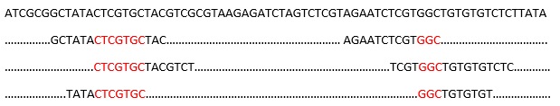
Reference Genome
Short Reads
Common Area Coverages

Slide 6
Sequence Alignment Mapping
Sequence Alignment Mapping (SAM) is a standard format to show how a specific alignment tool made alignment on several reads with any other genome reference.

Slide 7
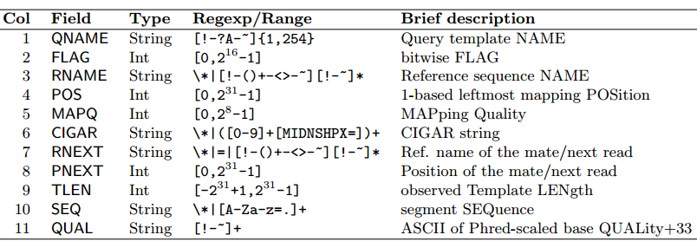
Sequence Alignment Mapping File Format Specifications

Slide 8
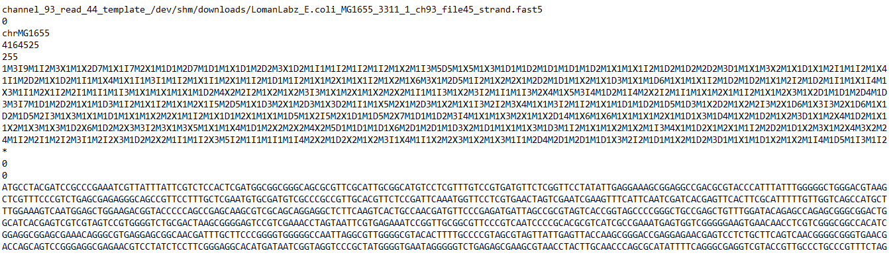

Slide 9
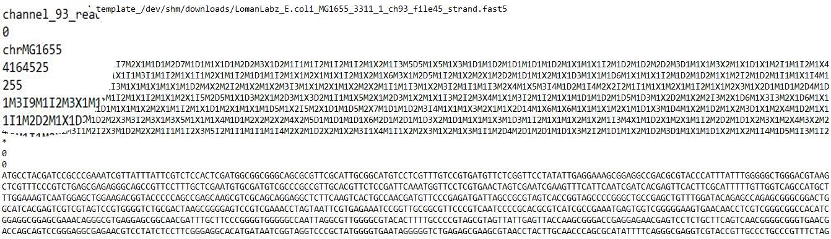

Slide 10
Tools To Evaluate SAM Files
Qualimap
Picard tools
RNA-SeQC
RSeQC

Slide 11
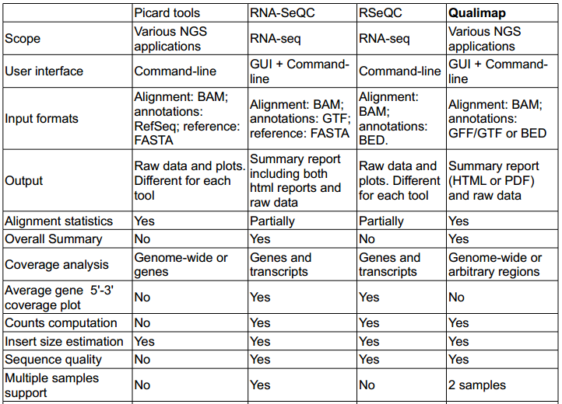

Slide 12
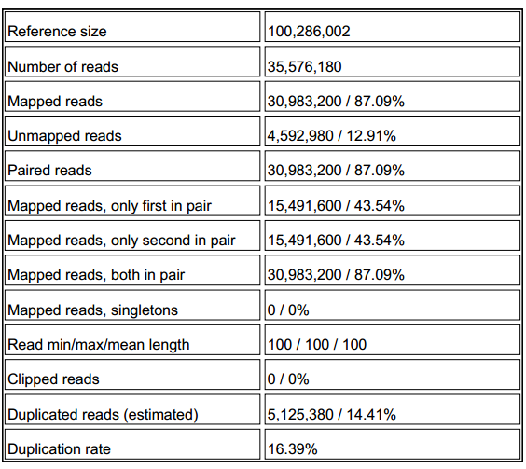
Qualimap Output

Slide 13
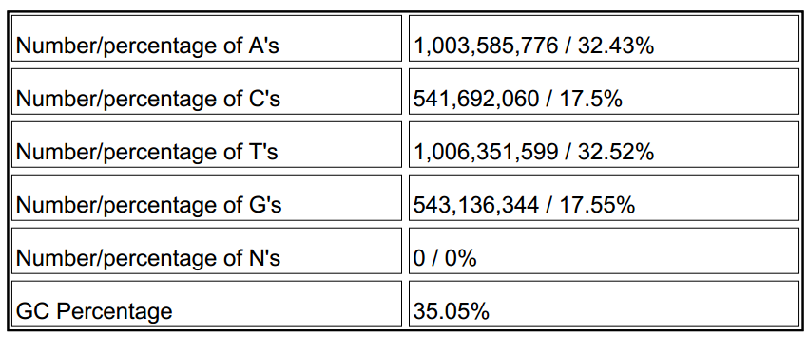
Qualimap Output

Slide 14
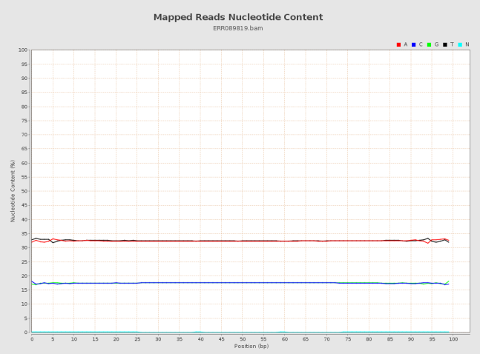

Slide 15
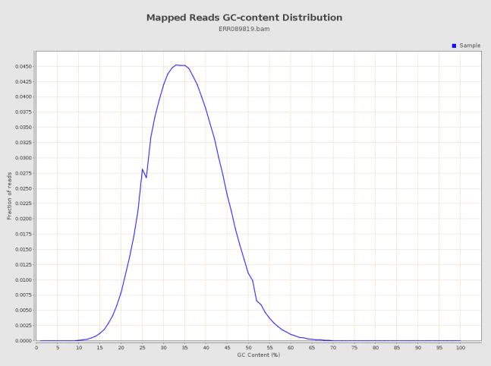

Slide 16
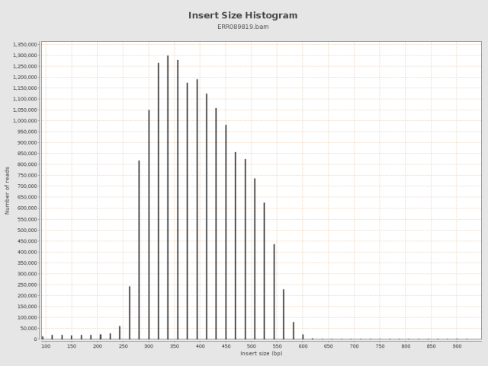

Slide 17
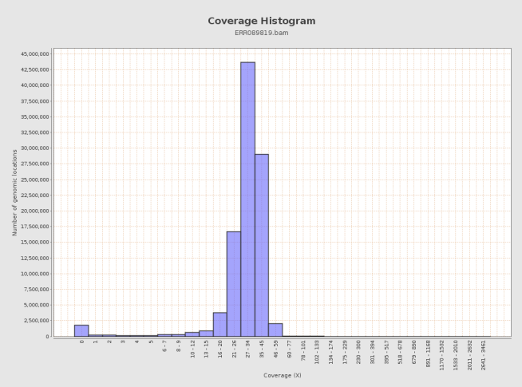

Slide 18
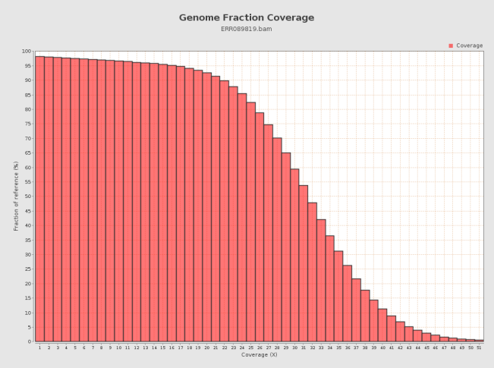

Slide 19
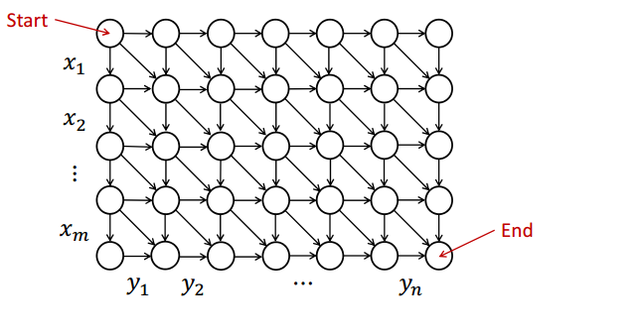
Path Graph

Slide 20
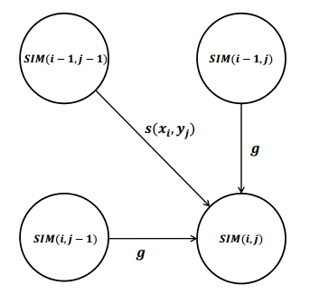
DP to Path Graph

Slide 21
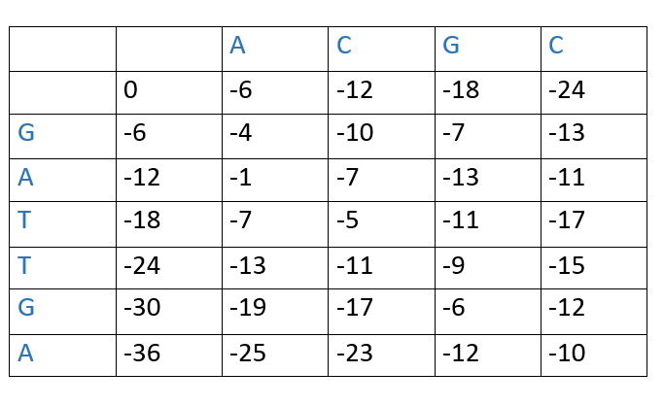
Match = 5 MisMatch = -4 Gap = -6

Slide 22
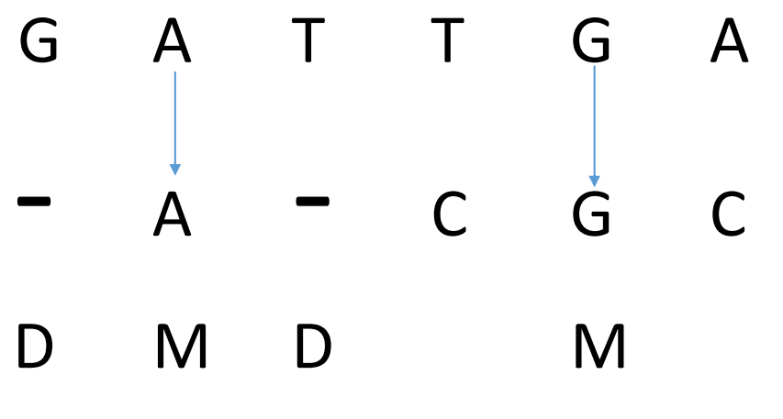
Aligned String

Slide 23
Scale Measurement Definition
Percentage of Identity means Percentage of Matches considering all penalties (insertion, deletion, mismatches)
POI = Total number of matches/ (Total Matches + Total Penalties)

Slide 24
Data Source
We took 1000 reads from SAM with minimum 100 length and maximum of 1000 length.
Counted-
Total Matches
Total Mismatches
Total Insertions
Total Deletions

Slide 25
Measuring Quality
Measured POI of sample data and compared with implemented alignment POI
If POI (from implemented alignment) > POI (from sample data) then quality falls otherwise it will be called better in this scale

Slide 26
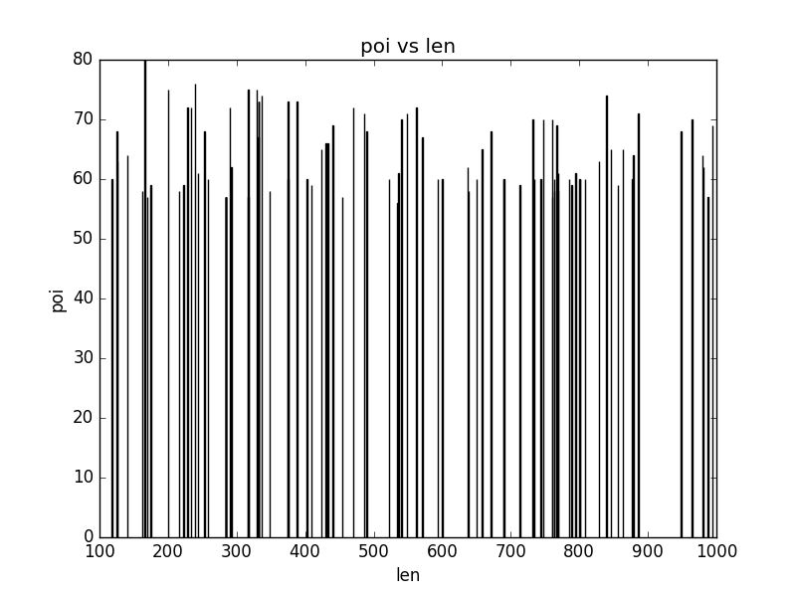
Max POI vs. Length

Slide 27
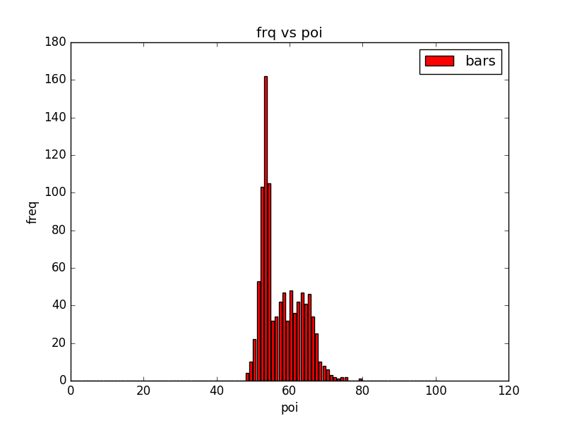
Frequency vs. POI (Global Alignment)

Slide 28
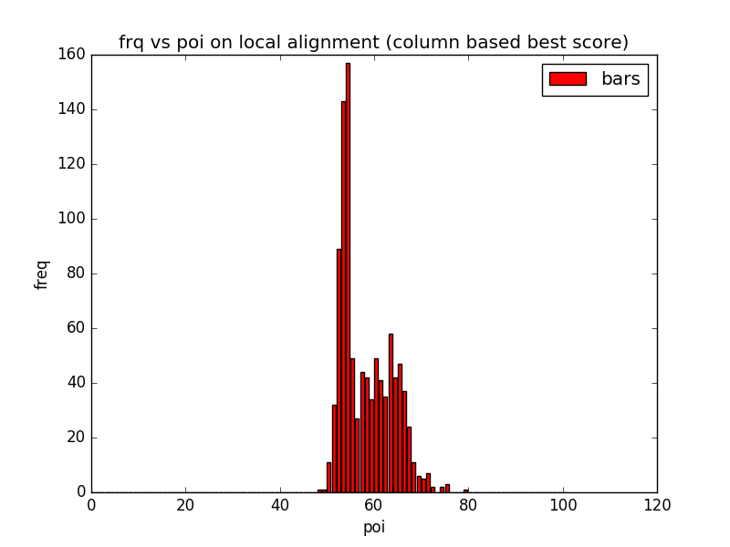
Local Alignment (Considering Column)

Slide 29
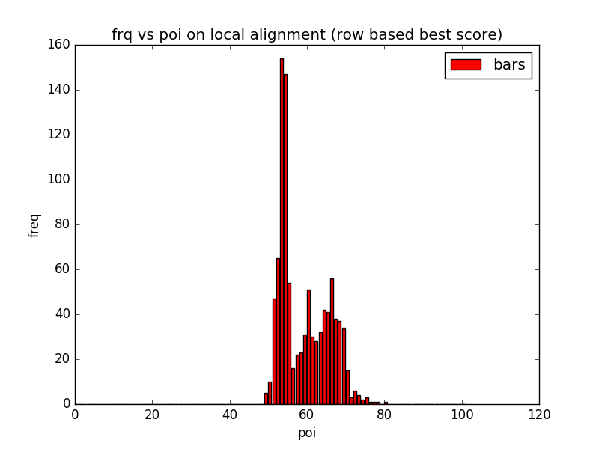
Local Alignment (Considering Row)

Slide 30
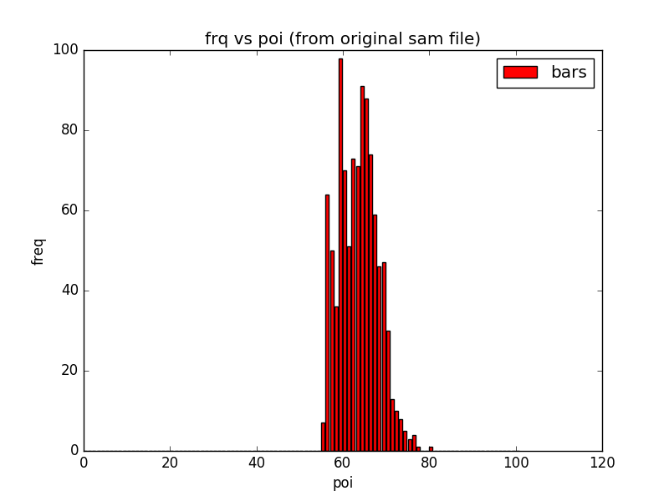
Freq. vs. POI (from experimented tool data set)

Slide 31
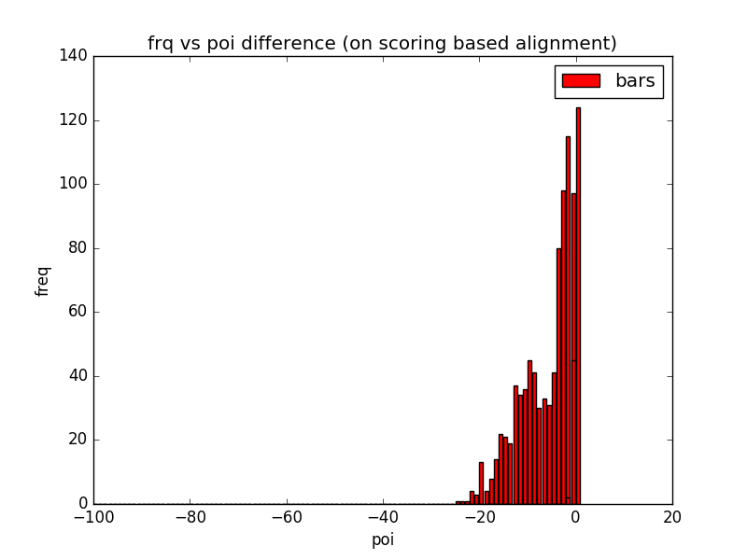
Difference with Implemented Global Alignment

Slide 32
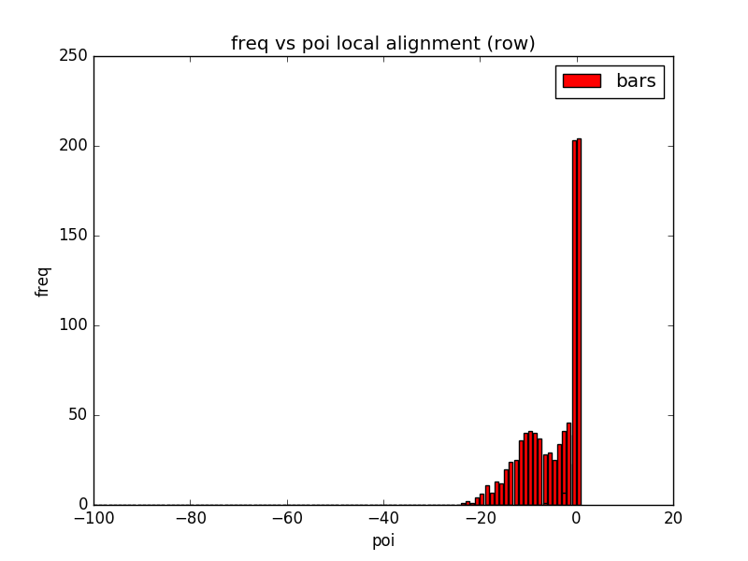
Difference with Implemented Local Alignment

Slide 33
Future Work
Optimization in the implemented naive algorithm
More analysis on making better alignment
Building memory optimized quality measurement and comparison tool

Slide 34
Thanks.. Questions….

